Slide 1

Parental Leave Dashboard
Parental Leave Policies
Crowdsourced parental leave data from 1,601 companies across different industries, including paid/unpaid maternity and paternity leave weeks.
Recommended Analysis
Which companies offer the most paid parental leave weeks?
Is maternity leave typically longer than paternity leave?
What is the distribution of parental leave weeks offered?
Are there noticable differences between industries?

Slide 2
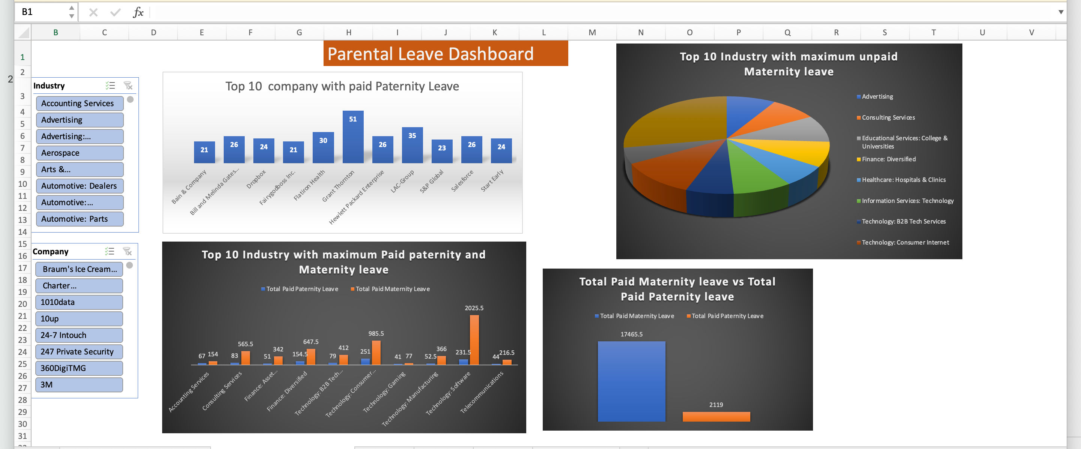

Slide 3
Insight from the dashboard
We can see the top 10 company which provide maximum 52 weeks of the paid paternity leave.
There are other companies which doesn’t have policy of paid paternity leave and these company should enforce this policy for employees.
There is a high difference between paid maternity leave and paid paternity leave.
Technology, Consumer Internet has the maximum unpaid maternity leave.
All the companies should made their policy similar and as per the govt rules for the maternity and paternity leave.

